Slide 1
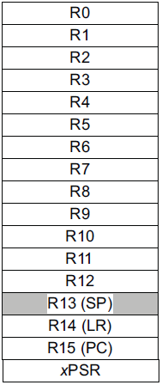
EECS 373
Design of Microprocessor-Based Systems
Prabal Dutta
University of Michigan
Lecture 2: Architecture, Assembly, and ABI
September 8, 2011
Slides developed in part by
Mark Brehob

Slide 2
Announcements
Website up
  http://www.eecs.umich.edu/~prabal/teaching/eecs373-f11/
Lab and office hours posted on-line.
  My office hours: Tuesdays 1:30-3:00 pm in 4773 CSE

Slide 3
Review
What distinguishes embedded systems?
  Application-specific
  Resource-constrained
  Real-time operations
  Software runs “forever”
Technology scaling is driving “embedded everywhere”
  Microprocessors
  Memory (RAM and Flash)
  Imagers (i.e. camera) and MEMS sensors (e.g. accelerometer)
  Energy storage/generation

Slide 4
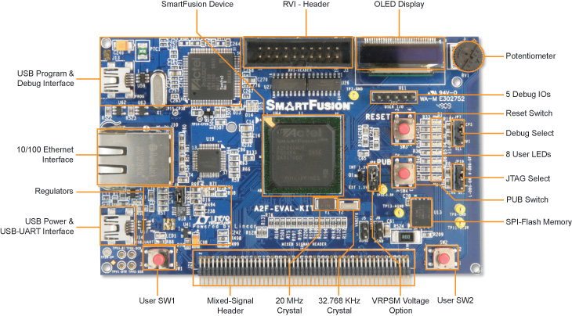
We are using Actel’s SmartFusion Evaluation Kit

Slide 5
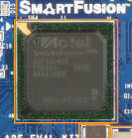
A2F200M3F-FGG484ES
  200,000 System FPGA gates, 256 KB flash memory, 64 KB SRAM, and additional distributed SRAM in the FPGA fabric and external memory controller
  Peripherals include Ethernet, DMAs, I²Cs, UARTs, timers, ADCs, DACs and additional analog resources
USB connection for programming and debug from Actel's design tools
USB to UART connection to UART_0 for HyperTerminal examples
10/100 Ethernet interface with on-chip MAC and external PHY
Mixed-signal header for daughter card support

Slide 6
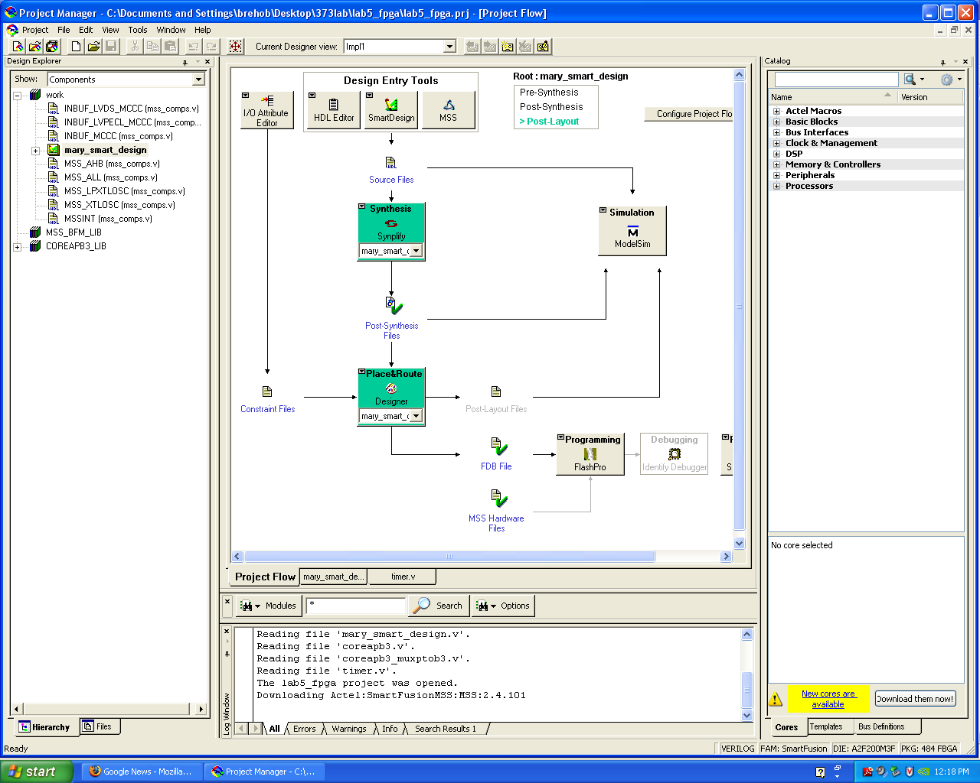
FPGA work

Slide 7
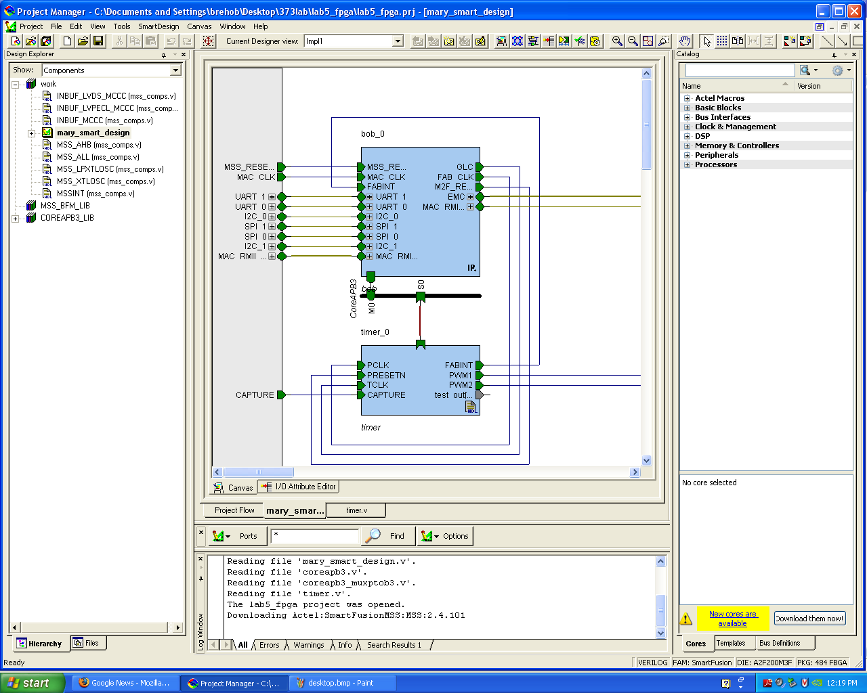
“Smart Design” configurator

Slide 8
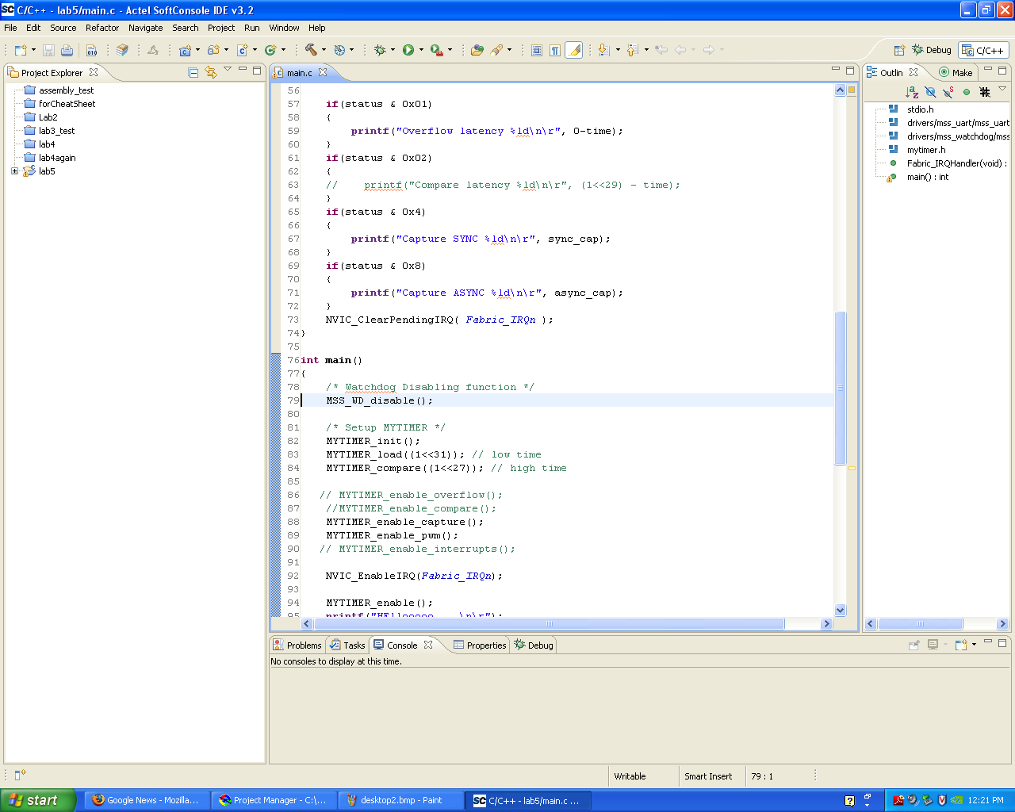
Eclipse-based “Actel SoftConsole IDE”

Slide 9
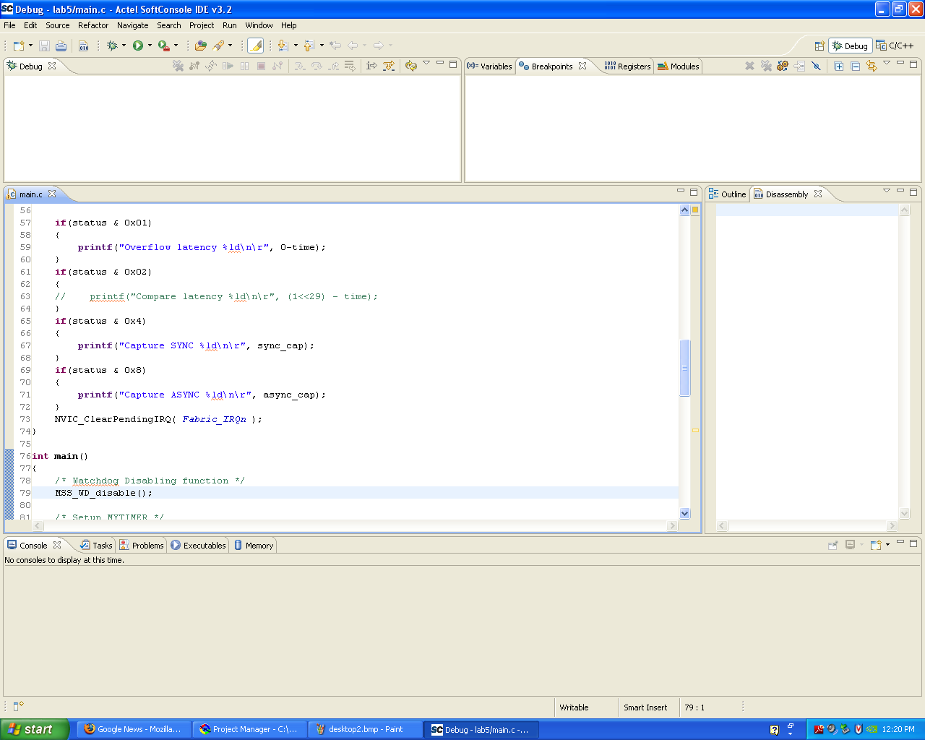
Debugger is GDB-based. Includes command line.

Slide 10
Architecture

Slide 11
In the context of computers,
what does architecture mean?

Slide 12
Architecture has many meanings
Computer Organization (or Microarchitecture)
  Control and data paths
  Pipeline design
  Cache design
  …
System Design (or Platform Architecture)
  Memory and I/O buses
  Memory controllers
  Direct memory access
  …
Instruction Set Architecture (ISA)

Slide 13
What is an
Instruction Set Architecture (ISA)?

Slide 14
Instruction Set Architecture
“Instruction set architecture (ISA) is the structure of a computer that a machine language programmer (or a compiler) must understand to write a correct (timing independent) program for that machine”
IBM introducing 360 in 1964

Slide 15
An ISA defines the hardware/software interface
A “contract” between architects and programmers
Register set
Instruction set
  Addressing modes
  Word size
  Data formats
  Operating modes
  Condition codes
Calling conventions
  Really not part of the ISA (usually)
  Rather part of the ABI
  But the ISA often provides meaningful support.

Slide 16
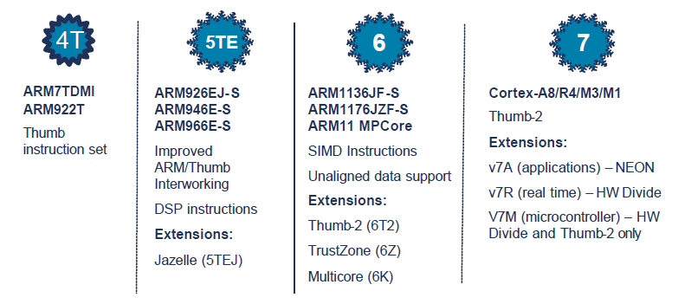
ARM Architecture roadmap

Slide 17
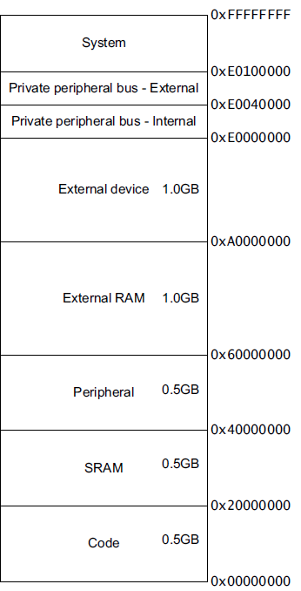
ARM Cortex-M3 ISA
Instruction Set
Register Set
Address Space
Branching
Data processing
Load/Store
Exceptions
Miscellaneous
32-bits
32-bits
Endianess
Endianess

Slide 18
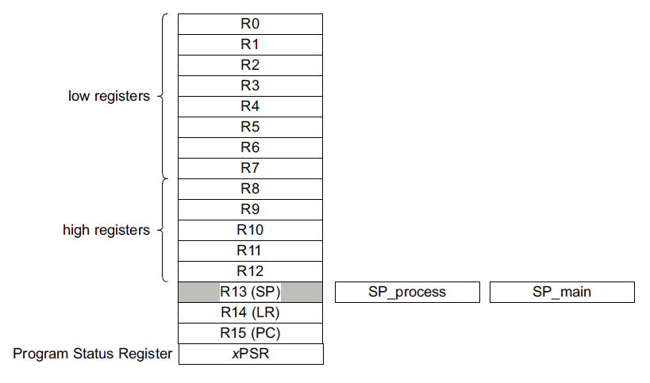
Registers
Mode dependent

Slide 19
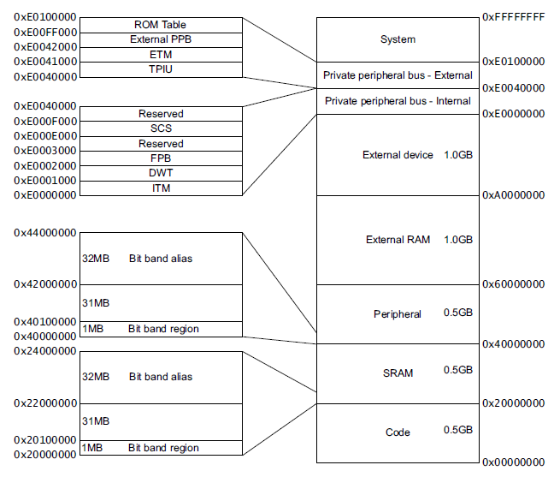
Address Space

Slide 20
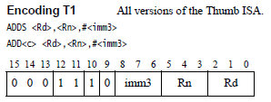
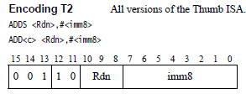


Instruction Encoding
ADD immediate

Slide 21
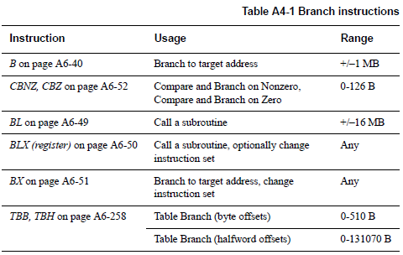
Branch

Slide 22
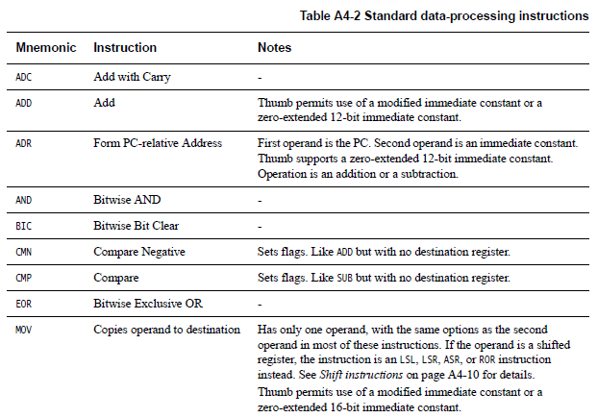
Data processing instructions
Many, Many More!

Slide 23
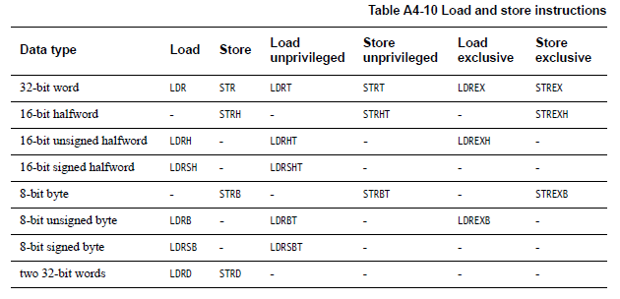
Load/Store instructions

Slide 24
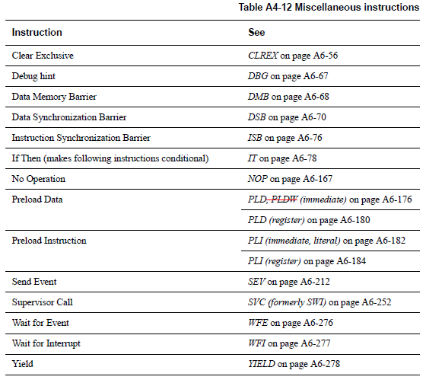
Miscellaneous instructions

Slide 25
Addressing Modes
Offset Addressing
  Offset is added or subtracted from base register
  Result used as effective address for memory access
  [<Rn>, <offset>]
Pre-indexed Addressing
  Offset is applied to base register
  Result used as effective address for memory access
  Result written back into base register
  [<Rn>, <offset>]!
Post-indexed Addressing
  The address from the base register is used as the EA
  The offset is applied to the base and then written back
  [<Rn>], <offset>
Notes:
Condition codes are simply a way of testing the ALU status flags.

Slide 26
<offset> options
An immediate constant
  #10
An index register
  <Rm>
A shifted index register
  <Rm>, LSL #<shift>
Lots of weird options…
Notes:
Condition codes are simply a way of testing the ALU status flags.

Slide 27
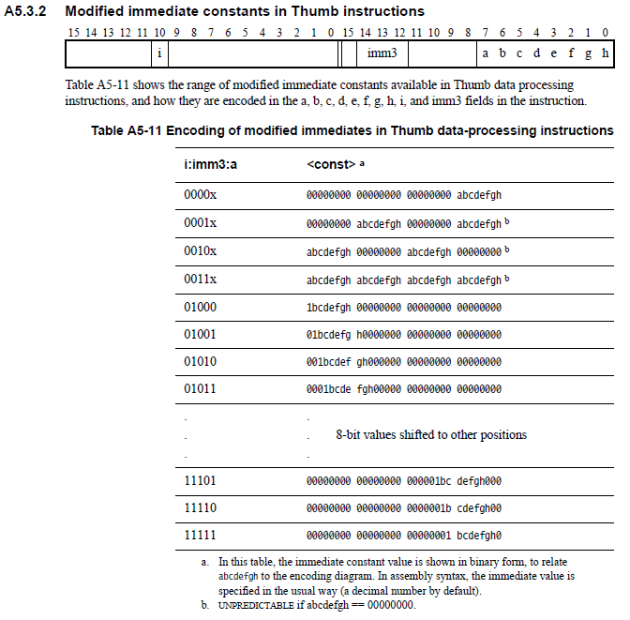
ARMv7-M Architecture Reference Manual
ARMv7-M_ARM.pdf

Slide 28
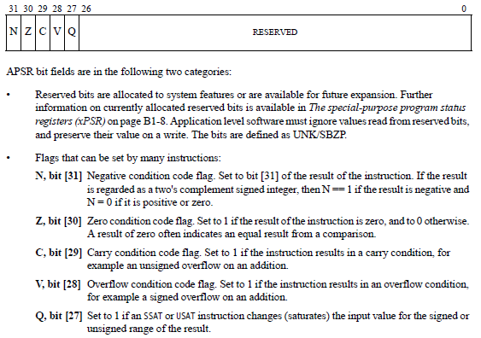
Application Program Status Register (APSR)
Notes:
Condition codes are simply a way of testing the ALU status flags.

Slide 29
Updating the APSR
SUB Rx, Ry
  Rx = Rx - Ry
  APSR unchanged
SUBS
  Rx = Rx - Ry
  APSR N, Z, C, V updated
ADD Rx, Ry
  Rx = Rx + Ry
  APSR unchanged
ADDS
  Rx = Rx + Ry
  APSR N, Z, C, V updated
Notes:
Condition codes are simply a way of testing the ALU status flags.

Slide 30
Overflow and carry in APSR
unsigned_sum = UInt(x) + UInt(y) + UInt(carry_in);
signed_sum = SInt(x) + SInt(y) + UInt(carry_in);
result = unsigned_sum<N-1:0>; // == signed_sum<N-1:0>
carry_out = if UInt(result) == unsigned_sum then ’0’ else ’1’;
overflow = if SInt(result) == signed_sum then ’0’ else ’1’;

Slide 31
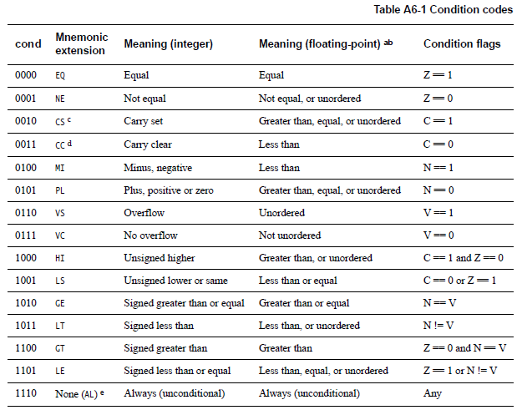
Conditional execution:
Append to many instructions for conditional execution
Notes:
Condition codes are simply a way of testing the ALU status flags.

Slide 32
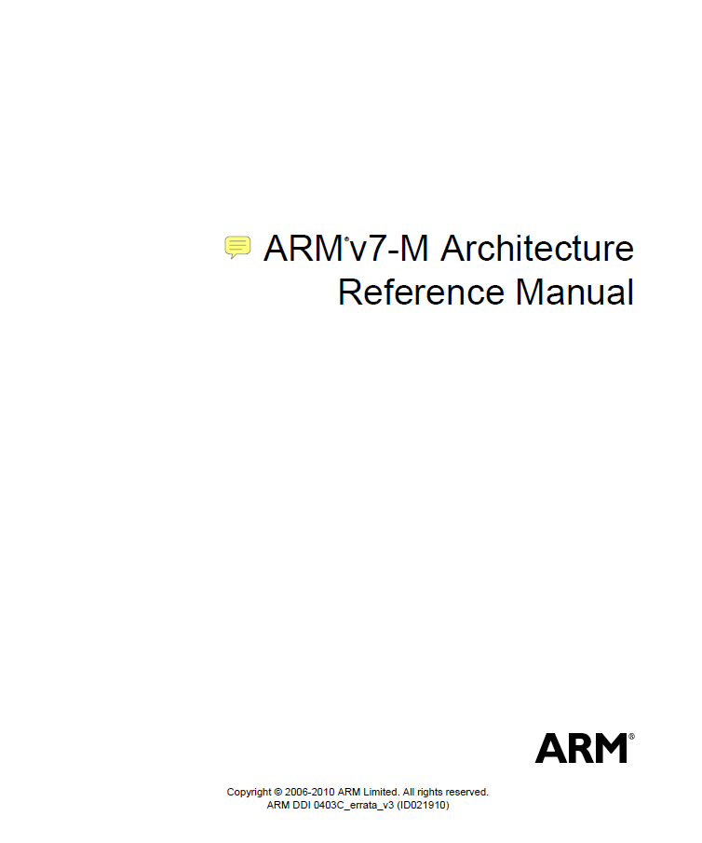
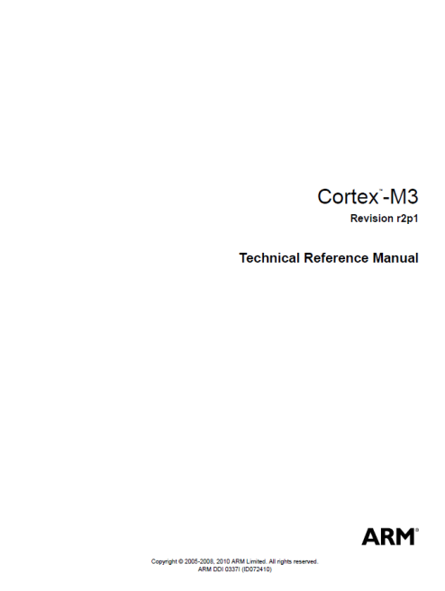
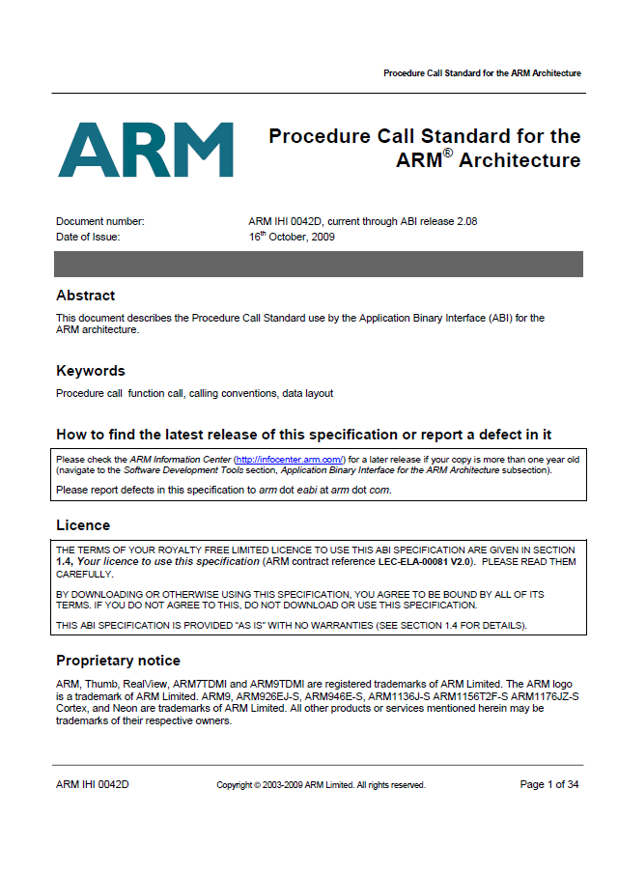



The ARM architecture “books” for this class

Slide 33
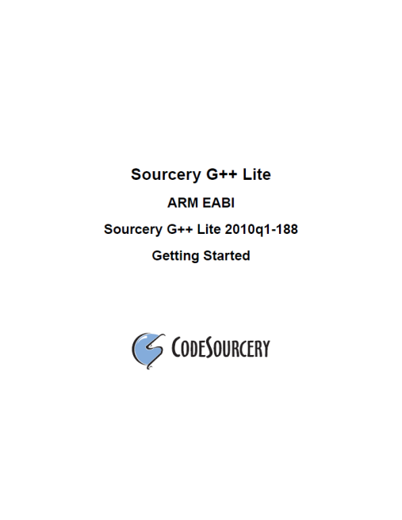
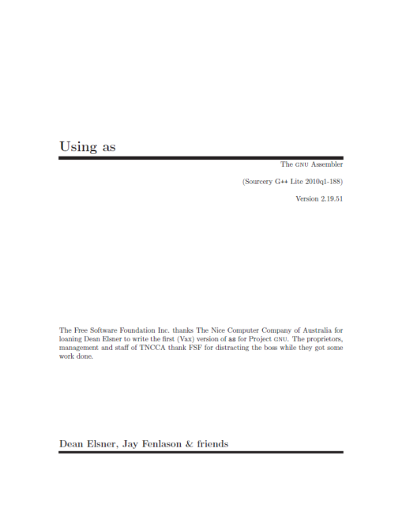
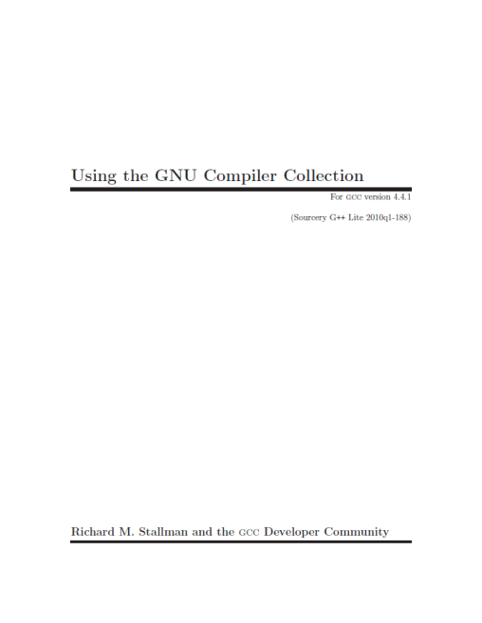
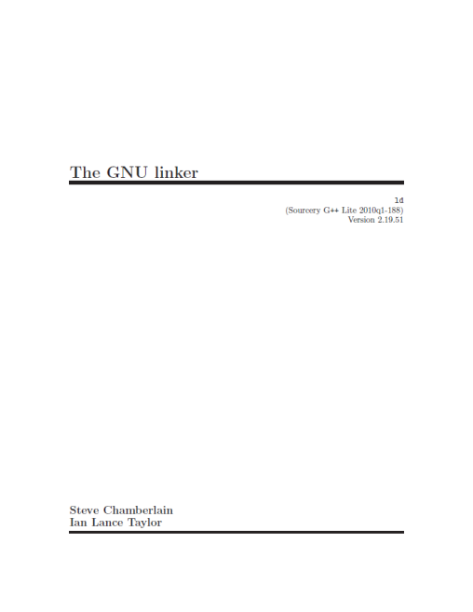
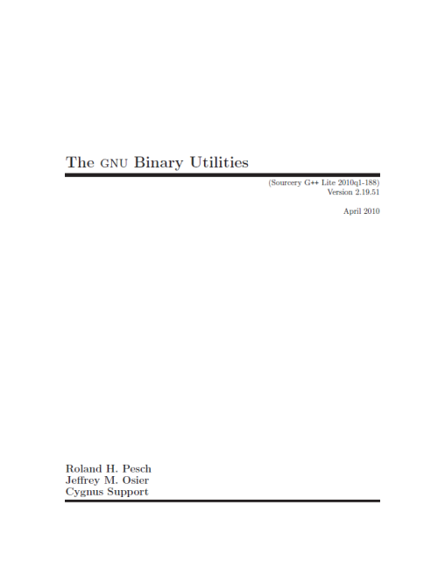
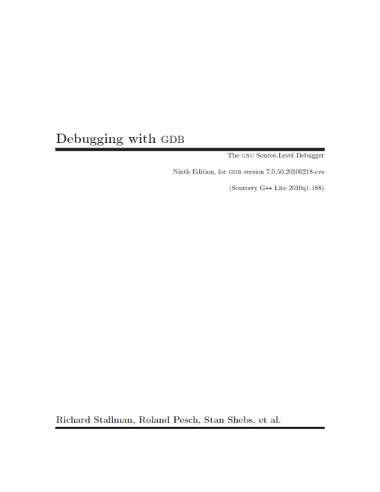
The ARM software tools “books” for this class

Slide 34
An ARM assembly language program for GNU
.equ STACK_TOP, 0x20000800
.text
.syntax unified
.thumb
.global _start
.type start, %function
_start:
.word STACK_TOP, start
start:
movs r0, #10
movs r1, #0
loop:
adds r1, r0
subs r0, #1
bne loop
deadloop:
b deadloop
.end

Slide 35
A simple Makefile
all:
arm-none-eabi-as -mcpu=cortex-m3 -mthumb example1.s -o example1.o
arm-none-eabi-ld -Ttext 0x0 -o example1.out example1.o
arm-none-eabi-objcopy -Obinary example1.out example.bin
arm-none-eabi-objdump -S example1.out > example1.list

Slide 36
An ARM assembly language program for GNU
.equ STACK_TOP, 0x20000800
.text
.syntax unified
.thumb
.global _start
.type start, %function
_start:
.word STACK_TOP, start
start:
movs r0, #10
movs r1, #0
loop:
adds r1, r0
subs r0, #1
bne loop
deadloop:
b deadloop
.end

Slide 37
Disassembled object code
example1.out: file format elf32-littlearm
Disassembly of section .text:
00000000 <_start>:
0: 20000800 .word 0x20000800
4: 00000009 .word 0x00000009
00000008 <start>:
8: 200a movs r0, #10
a: 2100 movs r1, #0
0000000c <loop>:
c: 1809 adds r1, r1, r0
e: 3801 subs r0, #1
10: d1fc bne.n c <loop>
00000012 <deadloop>:
12: e7fe b.n 12 <deadloop>

Slide 38
Questions?
Comments?
Discussion?

